Slide 1
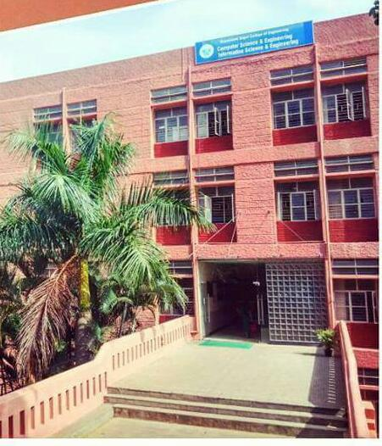

Slide 2
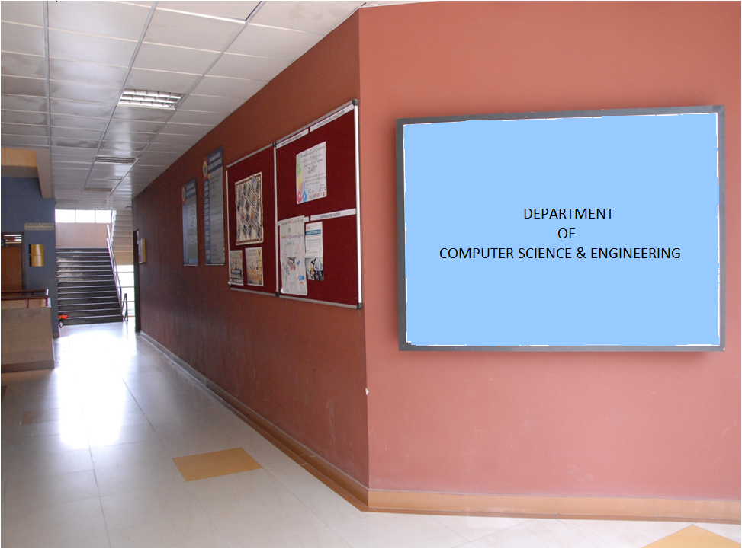

Slide 3

Lab Program 11
Write a C/C++ Program for Congestion control using Leaky Bucket Algorithm.
DAYANANDA SAGAR COLLEGE OF ENGINEERING

Slide 4

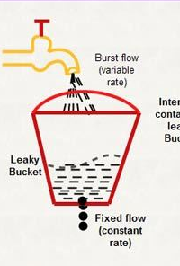
Leaky Bucket
If a bucket has a small hole at the bottom, the water leaks from the bucket at a constant rate as long as there is water in the bucket.
The rate at which the water leaks does not depend on the rate at which the water is input to the bucket unless the bucket is empty.
The input rate can vary, but the output rate remains constant.
Similarly, in networking, a technique called leaky bucket can smooth out bursty traffic. Bursty chunks are stored in the bucket and sent out at an average rate.
DAYANANDA SAGAR COLLEGE OF ENGINEERING

Slide 5
Leaky bucket algorithm
The leaky bucket algorithm is a method of temporarily storing a variable number of requests and organizing them into a set-rate output of packets in an asynchronous transfer mode (ATM) network.
Applications
The leaky bucket is used to implement traffic policing and traffic shaping in Ethernet and cellular data networks.
The algorithm can also be used to control metered-bandwidth Internet connections to prevent going over the allotted bandwidth for a month, thereby avoiding extra charges.
DAYANANDA SAGAR COLLEGE OF ENGINEERING

Slide 6

Figure Leaky bucket
DAYANANDA SAGAR COLLEGE OF ENGINEERING

Slide 7
For example ,
In the figure, Assume that the network has committed a bandwidth of 3 Mbps for a host.
The use of the leaky bucket shapes the input traffic to make it confirm to this data rate commitment.
As shown in figure, the host sends a burst of data at a
Rate of 12 Mbps for 2 s, total of 24 Mbits of data.
The host is silent for 5 s and then sends data at a
Rate of 2 Mbps for 3 s, for a total of 6 Mbits of data.
In all, the host has sent 30 Mbits of data in 10s.
The leaky bucket smoothens the traffic by sending out data at a rate of 3 Mbps during the same 10s.
DAYANANDA SAGAR COLLEGE OF ENGINEERING

Slide 8
Without the leaky bucket, the beginning burst may have hurt the network by consuming more bandwidth than is set aside for this host. We can see that the leaky bucket may prevent congestion.
A simple leaky bucket implementation is shown in Figure 24.20.
A FIFO queue holds the packets.
If the traffic consists of fixed-size packets (e.g., cells in ATM networks), the process removes a fixed number of packets from the queue at each tick of the clock.
If the traffic consists of variable-length packets, the fixed output rate is based on the number of bytes or bits.
DAYANANDA SAGAR COLLEGE OF ENGINEERING

Slide 9

Figure Leaky bucket implementation
DAYANANDA SAGAR COLLEGE OF ENGINEERING

Slide 10
Leaky Bucket Algorithm
The following is an algorithm for variable-length packets:
Initialize a counter to n (bucket size) at the tick of the clock.
2. If n is greater than the size of the packet, send the packet and decrement the counter by the packet size. Repeat this step until n is smaller than the packet size.
3. Reset the counter and go to step 1.
DAYANANDA SAGAR COLLEGE OF ENGINEERING

Slide 11
#include<stdio.h>
#include<stdlib.h>
struct packet
{ int time;
int size;
} p[50];
int main()
{
int i,n,m,k=0;
int bsize,bfilled,outrate;
printf("Enter the number of packets: ");
scanf("%d",&n);
DAYANANDA SAGAR COLLEGE OF ENGINEERING

Slide 12
printf("Enter packets in the order of their arrival time\n");
for(i=0;i<n;i++)
{
printf("Enter the time and size: ");
scanf("%d%d",&p[i].time, &p[i].size);
}
printf("Enter the bucket size: ");
scanf("%d",&bsize);
printf("Enter the output rate: ");
scanf("%d",&outrate);
DAYANANDA SAGAR COLLEGE OF ENGINEERING

Slide 13
m=p[n-1].time; i=1; k=0; bfilled=0;
while(i<=m || bfilled!=0)
{
printf("\n\nAt time %d",i);
if(p[k].time==i )
{
if(bsize>=bfilled + p[k].size)
{ bfilled=bfilled + p[k].size;
printf("\n%d byte packet is inserted",p[k].size);
k=k+1;
}
else
{ printf("\n%d byte packet is discarded",p[k].size);
k=k+1;
}
}
DAYANANDA SAGAR COLLEGE OF ENGINEERING

Slide 14
if (bfilled==0)
{ printf("\nNo packets to transmitte");
}
else if(bfilled>=outrate)
{ bfilled=bfilled-outrate;
printf("\n%d bytes transfered",outrate);
}
else
{ printf("\n%d bytes transfered",bfilled);
bfilled=0;
}
printf("\nPackets in the bucket %d byte",bfilled); i++;
} return 0;
}
DAYANANDA SAGAR COLLEGE OF ENGINEERING

Slide 15
Example Output1 :
Enter the number of packets: 3
Enter packets in the order of they are arrival time
Enter the time and size: 1 100
Enter the time and size: 2 400
Enter the time and size: 3 600
Enter the bucket size: 500
Enter the output rate: 200
DAYANANDA SAGAR COLLEGE OF ENGINEERING

Slide 16
At time 1
100 byte packet is inserted
100 bytes transfered
Packets in the bucket 0 byte
At time 2
400 byte packet is inserted
200 bytes transfered
Packets in the bucket 200 byte
At time 3
600 byte packet is discarded
200 bytes transfered
Packets in the bucket 0 byte
bucket size: 500
output rate: 200
DAYANANDA SAGAR COLLEGE OF ENGINEERING

Slide 17
Example Output 2
Enter the time and size: 1 100
Enter the time and size: 3 200
Enter the time and size: 2 400
Enter the time and size: 4 600
Enter the bucket size: 200
Enter the output rate: 100
At time 1
100 byte packet is inserted
100 bytes transfered
Packets in the bucket 0 byte
At time 2
No packets to transmitted
Packets in the bucket 0 byte
At time 3
200 byte packet is inserted
100 bytes transfered
Packets in the bucket 100 byte
At time 4
100 bytes transfered
Packets in the bucket 0 byte
DAYANANDA SAGAR COLLEGE OF ENGINEERING

Slide 18
DAYANANDA SAGAR COLLEGE OF ENGINEERING

